Slide 1
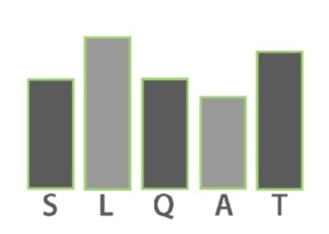
A Research-Based Tool for Supporting and Determining the Quality of Service-Learning Courses

Slide 2
What was the intent?
A tool that brings together research-based components of SL quality and can be consistently rated could provide deeper insight into how elements work together, and improve sophistication of outcomes research
Such an instrument could be used for:
research
self-assessment
professional development
course design…
Notes:
Andy

Slide 3
What is the SLQAT?
The “Service-Learning Quality Assessment Tool”
An instrument to rate the quality of design and implementation of service-learning courses
Incorporates 28 “essential elements” from research on high quality service-learning, organized into five dimensions
Elements are rated based on presence and level/quality of implementation
Elements also carry a “weight,” based on presumed importance to service-learning outcomes, which combines with the level of implementation
Notes:
Paul

Slide 4
Dimensions & Elements of the SLQAT
Dimension I: Course Design | Element #1: Articulation of Service-Learning in Syllabus Element #2: Reflection Element #3: Diverse Perspectives Element #4: Assessment of Student Performance Element #5: Flexibility in Course Design / Implementation Element #6: Reciprocity Element #7: Feedback Element #8: Risk Management Element #9: Use of Resources and Support for Service-Learning Element #10: Planning and Articulation of Service Activity
Notes:
PAUL

Slide 5
Dimensions & Elements of the SLQAT
Dimension II: Learning | Element #11: Academic Content Learning from Service-Learning Element #12: Societal Issues Learning from Service-Learning Element #13: Personal or Professional Learning from Service-Learning Element #14: Appropriateness of Service Activities for Students Element #15: Connection between Service and Learning Element #16: Authentic Community-Based Need Element #17: Appropriate Duration/Intensity of Service
Notes:
PAUL

Slide 6
Dimensions & Elements of the SLQAT
Dimension III: Student | Element #18: Student Preparedness for Service-Learning Element #19: Relevance of Service Activity Element #20: Student Voice
Dimension IV: Instructor | Element #21: Instructor’s Knowledge of Service-Learning Pedagogy Element #22: Instructor’s Knowledge of Community Element #23: Instructor’s Knowledge of Societal Issues
Dimension V: Community Partner & Partnership | Element #24: Site/Partner Appropriateness Element #25: Supervision and Guidance of Students Element #26: Community Partner Co-Educator Role Element #27: Community Capacity for Service-Learning Element #28: Instructor and Community Partner Connection
Notes:
PAUL

